Slide 1



REVENUE PERFORMANCE
Understanding business performance and customers behavioural
ONLINE RETAIL ANALYSIS
Shop with Trust
Our mission is to provide reliable service that can meet our customers demand as well as improve the least performed products and countries.
Items based on category

Slide 2

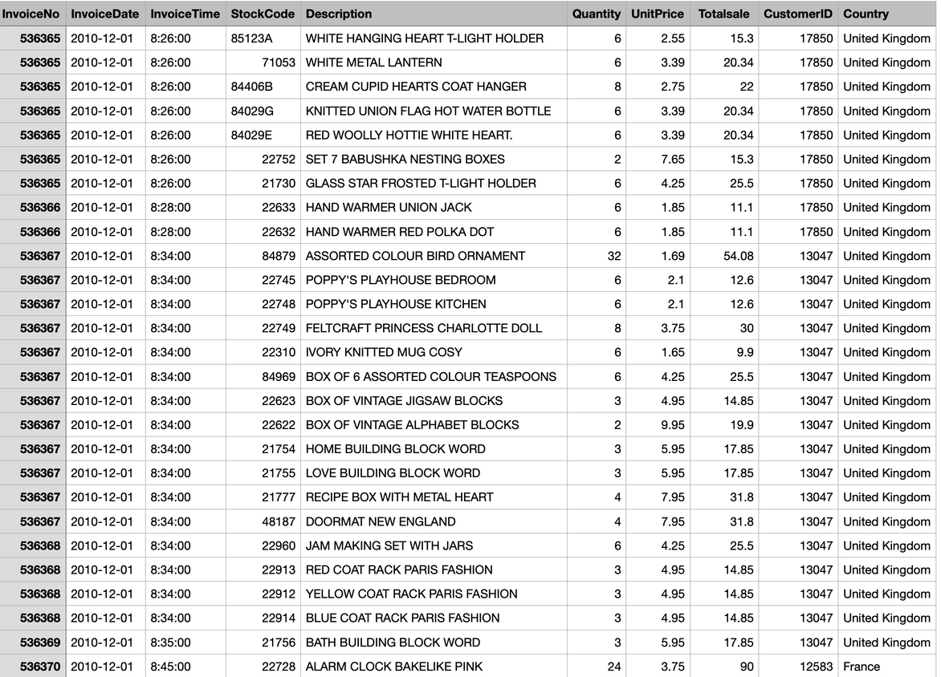
Dataset Information
Step 1
Finding dataset from online platform Kaggle.com
The raw file has dataframe with 10 columns and 541,909 rows

Slide 3

Step 2
Data cleaning in excel
Importing into POSTGRESSQL through terminal
.mode csv
.import *filepath with saved csv file* retail
.output retail.sql
.dump retail
Edit the retail.sql in TEXTNOTE before loading into POSTGRESSQL

Slide 4

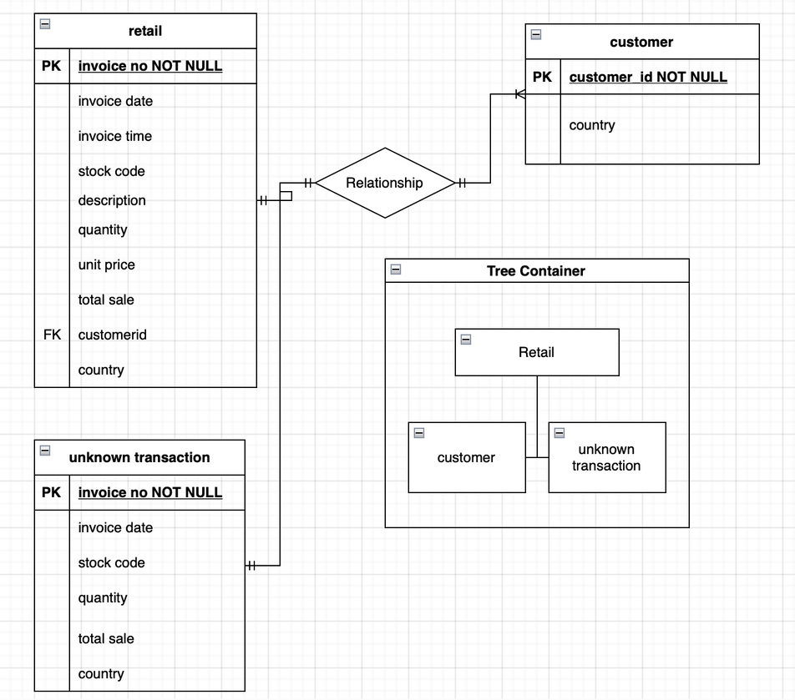
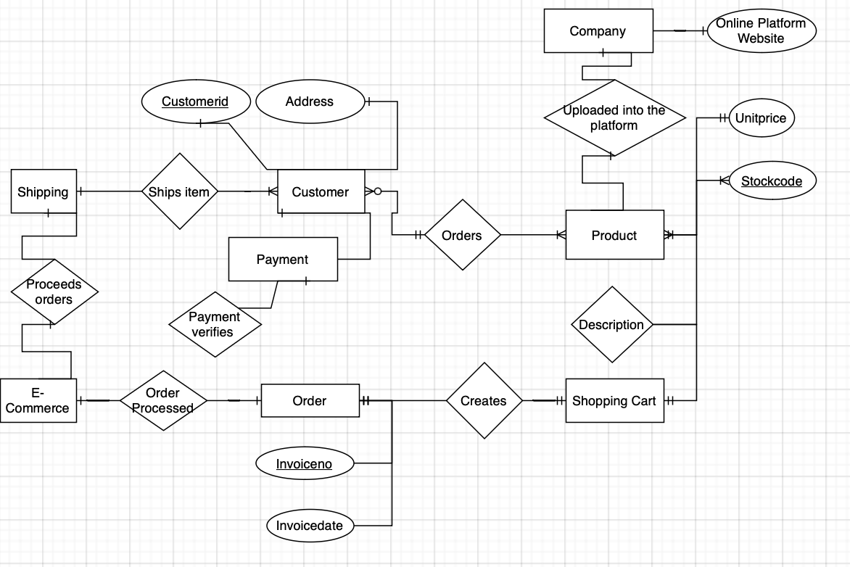
Entity Relationship Diagram
&
Schema Table

Slide 5

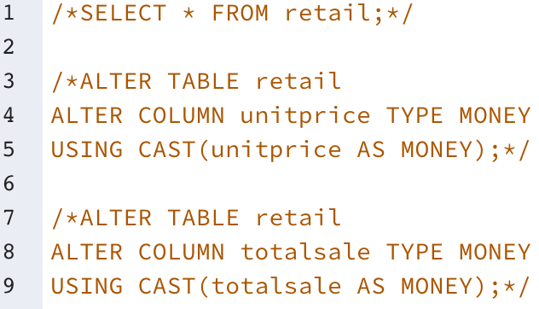
SQL Queries
Data cleaning and editing
ALTER
DATA
SET TYPE
USING
CAST
COLUMN
AS MONEY
FROM
TEXT

Slide 6

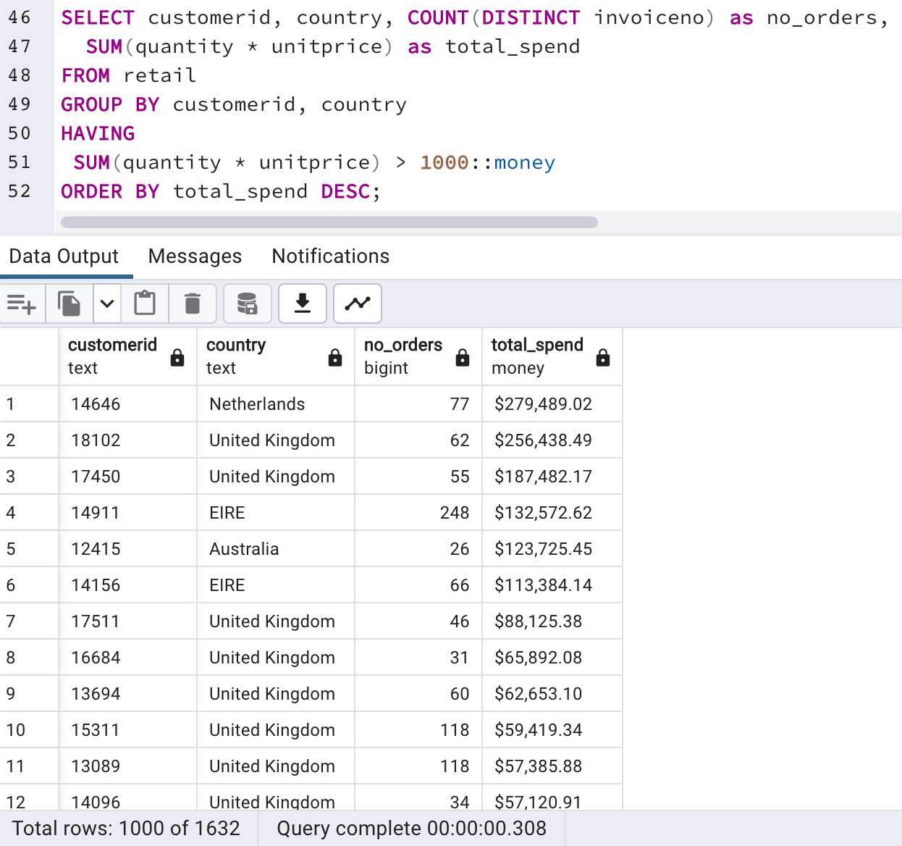
SQL QUERIES
Highest profit based on country and customer
Netherlands has the highest transaction followed by United Kingdom
Customer id: 14646 has the highest number of orders with total spending of $279,489.02

Slide 7

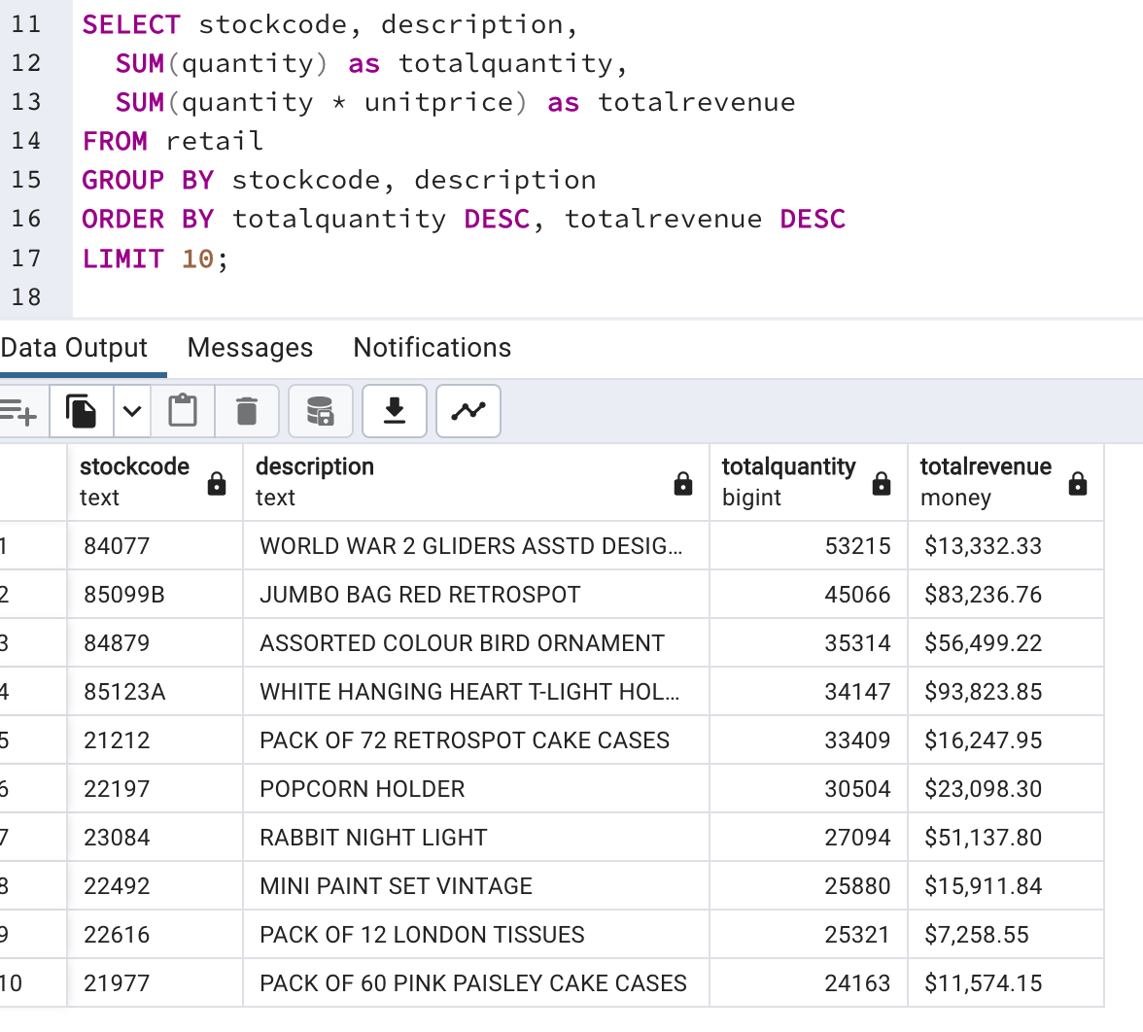
SQL queries
Top 10 transaction by product
Stockcode 84077 - WW2 Gliders was the most number of quantity transacted with total quantity of 53215
Stockcode 85123A - White Hanging Heart T-Light Holder is the highest revenue among the top 10 list

Slide 8

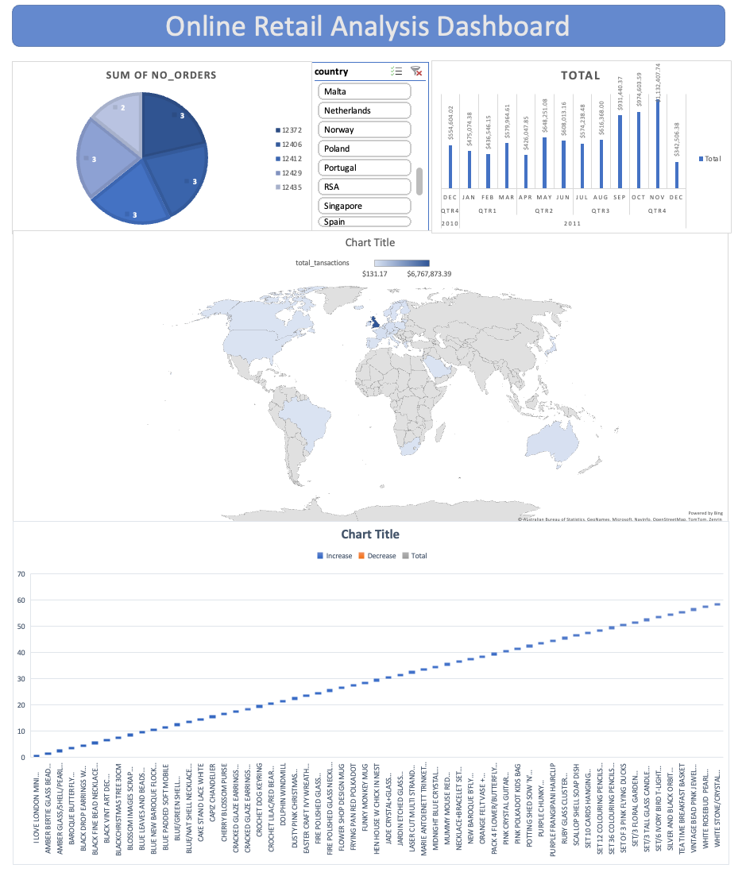
ANALYSIS
FINDING
Majority customers are from United Kingdom
The analysis shows the total revenue has been increasing
Data cleaning took more time as there was no proper categories of products

Slide 9

Challenges
&
Recommendations
Challenges
I will recommend for the data to be included with specific type of list, including categories, customer name, customer email, and customer address.
The data was taken from year 2010 Q4 to 2011 Q4. Hence, the data shown was only for the short period.
Recommendations
I recommend the e-commerce platform to improve their marketing by focusing on the most profitable country such as Netherlands and United Kingdom with delivery service waive off options or promotions.
To improve the area of customer demand based on the country and the culture for the least number of transaction country, in this dataset it is Saudi Arabia

Slide 10


